Slide 1
SMT 收音机装接 SMT radio install
《无线电装接工实训》 任课教师：孙宏光

Slide 2
Catalog 目录
Introduction to SMT technology
SMT技术简介
SMT radio install
SMT收音机装接

Slide 3
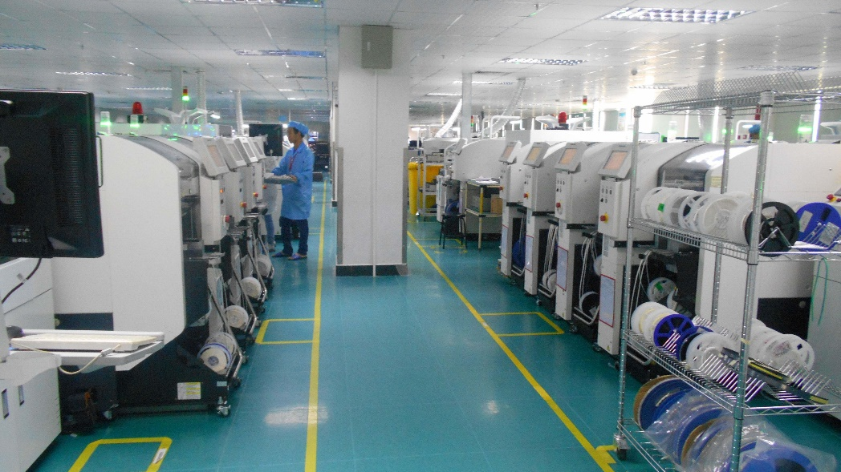
Introduction to SMT technology SMT技术简介
What is SMT?
SMT is the surface mount technology , is a kind of technique and technology of the electronic assembly industry's most popular.
什么是SMT ？
SMT就是表面组装技术（Surface Mounted Technology的缩写），是目前电子组装行业里最流行的一种技术和工艺。

Slide 4
Introduction to SMT technology SMT技术简介
Why use SMT?
1. Electronic products are becoming miniaturized, and previously used through hole plug-in components have been unable to shrink.
2. Electronic products are more functional, and the integrated circuit (IC) has no perforated components, especially large scale and high integration IC, so it has to adopt surface mount devices.
3. Batch production, production automation, the factory should produce high-quality products at low cost and high output to meet customer needs and strengthen market competitiveness.
4. The development of electronic components, the development of integrated circuits (IC), and the multiple applications of semiconductor materials
5. Electronic technology revolution is imperative, chasing international trends

Slide 5
Introduction to SMT technology SMT技术简介
为什么要用SMT?
1、电子产品追求小型化，以前使用的穿孔插件元件已无法缩小。
2、电子产品功能更完整，所采用的集成电路(IC)已无穿孔元件，特别是大规模、高集成IC，不得不采用表面贴片元件。 3、产品批量化，生产自动化，厂方要以低成本高产量，出产优质产品以迎合顾客需求及加强市场竞争力。
4、电子元件的发展，集成电路(IC)的开发，半导体材料的多元应
5、电子科技革命势在必行，追逐国际潮流

Slide 6
Introduction to SMT technology SMT技术简介
SMT technology development SMT 技术发展
Published in 1970s, the installation technology of mature surface in 80s, from component to installation, connection from the PCB design method to show a new look, which makes electronic products smaller, lighter weight, enhance the function, improve the reliability, promote the rapid development of information industry.
20世纪70年代问世，80年代成熟的表面安装技术(Surface Mounting Technology简称SMT)，从元器件到安装方式，从PCB设计到连接方法都以全新面貌展现，它使电子产品体积缩小，重量变轻，功能增强，可靠性提高，推动了信息产业高速发展。
SMT has replaced the traditional through-hole installation technology in many fields, and this trend is still developing. It is expected that more than 90% of the products will be SMT in the future.
SMT已经在很多领域取代了传统的通孔安装技术（THT），并且这种趋势还在发展，预计未来90％以上的产品将采用SMT。

Slide 7
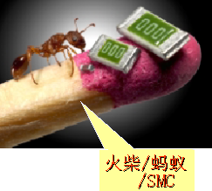
Match / ant / SMC 火柴／蚂蚁／ＳＭＣ

Slide 8
Introduction to SMT technology SMT技术简介
surface mount device 表面贴装元器件
Most surface mount components are chip, so it is also called "chip device" or "surface mount component"". Surface mount devices are generally referred to as SMC; surface mount devices are generally referred to as SMD. Surface mount printed boards are generally referred to as SMB.
大部分表面贴装元器件为片式，所以又称“片状元器件”或“表面贴元器件”。表面贴装元件一般简称SMC；表面贴装器件一般简称SMD。表面贴装印制版一般简称SMB。
Surface mount element include resistors, potentiometers, capacitors, inductors, switches, connectors (0), etc..
表面贴元件包括电阻、电位器、电容、电感、开关、连接器（0Ω）等。
Surface mount devices have discrete devices (diodes, transistors, thyristors); integrated circuits.
表面贴器件有分立器件（二极管、三极管、可控硅）；集成电路。

Slide 9
Introduction to SMT technology SMT技术简介
Surface mount components in practical training products
实训产品中的表面贴元器件
resistor chip
Specifications: 2.0mm * 1.25mm, thickness 0.4mm; resistance value is directly marked on the component by digital method. (positive and negative side)
片状电阻
规格：2.0mm×1.25mm，厚度0.4mm；电阻值采用数码法直接标在元件上。（有正反面）
This face up
562: 56 x 10^2 = 5600=5.6K
resistor chip

Slide 10
Introduction to SMT technology SMT技术简介
Surface mount components in practical training products
实训产品中的表面贴元器件
capacitor chip
Specification: 2.0mm * 1.25mm, thickness 0.5mm; capacitance value is expressed by digital method, but not printed on component. (without a positive or negative side)
片状电容
规格：2.0mm×1.25mm，厚度0.5mm；电容值采用数码法表示，但不印在元件上。（无正反面）
capacitor chip

Slide 11
Introduction to SMT technology SMT技术简介
Surface mount components in practical training products
实训产品中的表面贴元器件
Surface mount triode
Specification: use SOT-23 type package.
表面贴三极管
规格：采用SOT-23型封装。
Surface mount triode

Slide 12
Introduction to SMT technology SMT技术简介
Surface mount components in practical training products
实训产品中的表面贴元器件
Surface mount integrated circuit
Specification: double row flat package SOP.
表面贴集成电路
规格：采用双列扁平封装SOP。
Surface mount integrated circuit

Slide 13
SMT radio install SMT收音机装接
Training product characteristics 实训产品特点
SMT FM radio assembly process SMT调频收音机组装流程
SMT component mount SMT元器件贴装
THT component welding THT元器件焊接

Slide 14
Training product characteristics 实训产品特点
An electrically tunable monolithic FM radio integrated circuit (C1088) is applied. The special low intermediate frequency (70kHz) technology is used, and the intermediate frequency transformer and the ceramic filter are omitted. The circuit is simple and reliable, and the tuning is convenient and accurate.
The receiving frequency is 87~108MHz.
It has higher receiving sensitivity.
Small size, easy to carry.
Wide power range (1.8~3.5V can work).
Squelch circuit can be tuned in the process of noise suppression.

Slide 15
Training product characteristics 实训产品特点
采用电调谐单片FM收音机集成电路C1088，应用特殊的低中频（70kHz）技术，外围省去了中频变压器和陶瓷滤波器，电路简单可靠，调谐方便准确。
接收频率为87~108MHz。
具有较高接收灵敏度。
外形小巧，便于携带。
电源范围宽(1.8~3.5V均可工作)。
静噪电路可抑制调谐过程中的噪声。

Slide 16
SMT FM radio assembly process
SMT调频收音机组装流程

Slide 17
SMT FM radio assembly process
SMT调频收音机组装流程

Slide 18
SMT component assemble SMT元器件组装
Silk screen solder paste 丝印焊膏
Manual mount 手工贴片
Reflow soldering 再流焊机焊接
SMT manual process SMT手工工艺全程

Slide 19
Silk screen solder paste 丝印焊膏
Manual printing of solder paste on a SMB board using a solder paste printer; 用焊膏印刷机在SMB板上手动印刷焊膏；
Note the angle at which the solder paste scraper is operating;注意焊膏刮板在操作时的角度；
Note that the SMB board must be positioned accurately;注意SMB板务必定位准确；
Clean the residual solder paste in the wire hole in time.及时清理丝网孔中的残留焊膏。

Slide 20
Manual mount 手工贴片
Use special pallets and tweezers on the assembly line in order of position.使用专用托盘、镊子在流水线上依据工位，顺序贴装。
Note that SMC and SMD should not be taken by hand;注意SMC、SMD不得用手取放；
Tweezers can not hold the leads of the components;镊子不可夹持元器件引线
Note the direction of the IC tag;注意IC标记方向；
The sheet resistors have positive and negative sides;片状电阻有正反面；
No labeled chip capacitor shall be accurately and promptly attached to the specified location;没有标记的片状电容应准确及时贴到指定位置；

Slide 21
Reflow soldering 再流焊机焊接
When the SMB board has been loaded into the welding machine tray, the components should be checked again for shifting or falling off;已贴装元器件的SMB板放入焊机托盘后，须再次检查元器件有无移位、脱落等现象，并纠正；
Operate the reflow soldering button for automatic welding;操作“再流焊”按键进行自动焊接；
Standard process cycle is about 4 minutes, after welding, the tray is sent out automatically;标准工艺周期约4分钟，焊接完毕后托盘自动送出；
Check welding quality and repair bad solder joint.检查焊接质量，修补不良焊点。

Slide 22
Small SMT equipment solder paste printing machine
小型SMT设备-焊膏印刷机

Slide 23
Sequential mount 顺序贴装

Slide 24
Manual mount 贴片

Slide 25
Manual mount 贴片

Slide 26
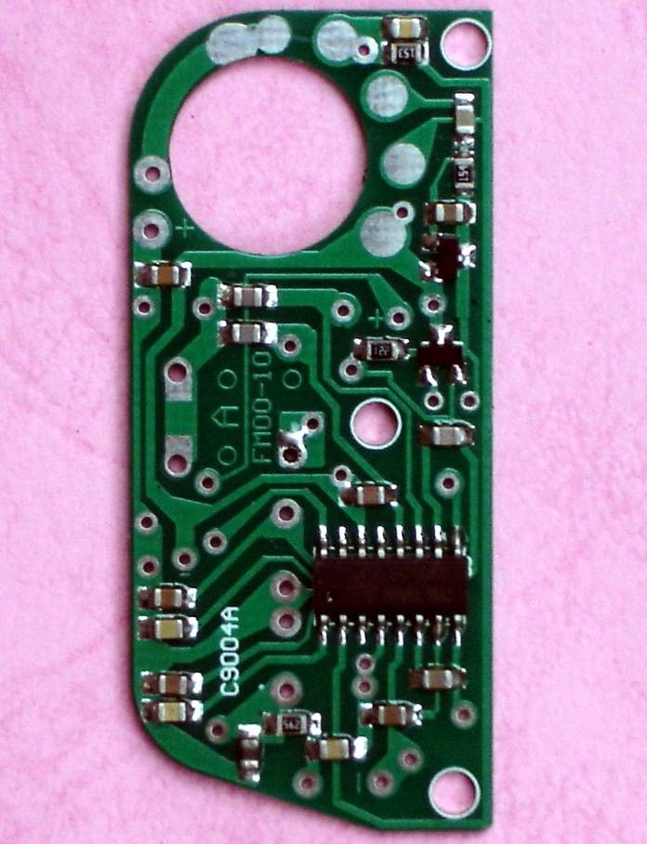
Mount finish 贴片完成
Check the number and position of the patch after reflow soldering.
The welding quality inspection of each component, the weld and weld, solder the lack of timely repair components.
Key check IC pin welding is good, adjacent pins exist "bridging"".
再流焊后，检查贴片数量及位置。
检查每个元器件的焊接质量，对虚焊、漏焊、焊料不足的元器件及时修补。
重点检查集成电路引脚焊接是否良好，相邻引脚是否存在“桥接”。

Slide 27
THT component welding THT元器件焊接

Slide 28
THT component welding THT元器件焊接
Installation and welding potentiometer Rp
installing potentiometer Rp.
Note that the potentiometer is flush with the printed board and reserve the line J1 hole position.
2. welding potentiometer Rp.
Three solder pads without wires outside the J1 hole are welded.
安装、焊接电位器Rp
1.安装电位器Rp。
注意电位器与印制板平齐,并预留连接线J1孔位。
2.焊接电位器Rp。
焊接没有连接线J1孔以外的三个焊盘。

Slide 29
THT component welding THT元器件焊接
Cross connection J1, J2 can be cut off the component lead wire installation.
跨接线J1、J2可用剪下的元件引线装接。

Slide 30
THT component welding THT元器件焊接
Headphone socket XS:
socket body for low temperature plastic, before welding pads on the tin, and flak holes.
2. first plug the headset into the socket, then welding, welding socket action should be rapid, so as not to plug overheating, deformation damage.
耳机插座XS：
1.插座体为低温塑料，焊前应先对焊盘上锡，并通好孔。
2.先将耳机插头插入插座中而后进行焊接，焊接插座时动作应迅速，以免插座过热变形损坏。

Slide 31
THT component welding THT元器件焊接
Welding varactor V1 (note SMB polarity mark and V1 polarity with Multimeter if necessary),
Contraposition mounting and welding of R5/680; R6/103
C17/332
C19 /223
焊接变容二极管V1(注意SMB极性标记，必要时用万用表判断V1极性)，
对位安装并焊接R5/680; R6/103
C17/332
C19 /223

Slide 32
THT component welding THT元器件焊接
Inductance coil Ll~L4
L1: magnetic ring
L2: color ring inductance
L3:8 turn coil
L4:5 turn coil
The spacing of the welding pads shall be adjusted and then inserted, so the welding time shall not be too long.
L3
L1
L2
电感线圈Ll~L4
L1：磁环
L2：色环电感
L3：8匝线圈
L4： 5匝线圈
应视焊盘间距整形后再插装，焊接时间不宜过长。
L4

Slide 33
THT component welding THT元器件焊接
Electrolytic capacitor C18 (100μF) mounted on board.
电解电容C18(100μF)贴板卧装。

Slide 34
THT component welding THT元器件焊接
Welding led V2
Pay attention to height and polarity.
焊接发光二极管V2
注意高度，极性。

Slide 35
THT component welding THT元器件焊接
Welding power supply line J3 and J4, pay attention to polarity and color.
焊接电源连接线J3、J4，注意极性与颜色。

Slide 36
THT component welding THT元器件焊接
Note the lead direction and polarity (wire color) when welding leads J3 and J4!
注意导线J3、J4焊接时的引出方向和极性（导线颜色）！

Slide 37
SMT FM radio submit SMT调频收音机交验
After assembly, load the battery and insert the headset for inspection,Requirement：
(1) the power switch feels good.
(2) the volume is normal and adjustable.
(3) listen to normal.
(4) no damage on the surface.
总装完毕，装入电池，插入耳机进行检查，
要求：
(1)电源开关手感良好。
(2)音量正常可调。
(3)收听正常。
(4)表面无损伤。

